Slide 1
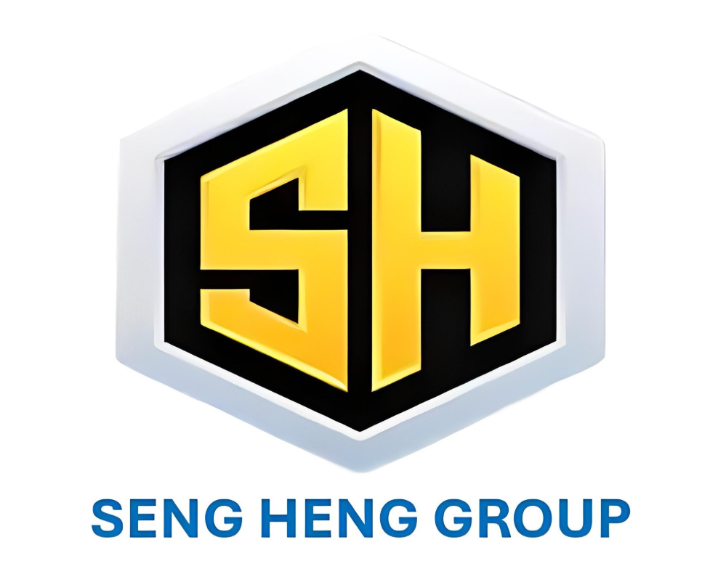

Slide 2
Our Group of company is SENG HENG MARINE PTE LTD SENG HENG OFFSHORE ENGINEEIRNG PTE LTD SENG HENG TECHNOLOGIES PTE LTD

Slide 3
ABOUT SENG HENG GROUP
Seng Heng Group is a BIZSAFE STAR certified company with a team of highly experienced and committed personnel
Seng Heng Group 7 days a week 365 days a year 24/7 to ensure that all over client’s requirements are expeditiously and effectively met.
Seng Heng Group has been registered and operating in Singapore since 2022
Seng Heng Group continued to upgrade ourselves to BIZSAFE STAR
The company continuously enhances its scope of services and quality improvement.
Projects include but are not limited to piping, coded welders(specialized in hull fabrication, preparing cutting and plan drawings and steel plate fabrication), hydraulic & mechanical repairs/conversions/additions at various shipyards, manpower supply in Singapore and offshore (Anchorage).
Manpower can be on a daily/hourly rate or a project to project basis if we are carrying out the full scope of works.
We provide competent skilled mechanical, electrical & hydraulic specialists, piping engineers, fitters and Supervisors, welders and multi skilled general workers.
Certified welders can be SMAW, FCAW, & GTAW - 3G, 4G, 6G & 6GR depending on what is required from the client.
Electrical specialists for terminations, cable runs, electrical hot works and panel removal/installation(we can also get the fabrication of the panel/s done if required).
We have previously or currently supply to the following companies as-well as the companies mentioned in the company profile attached:
ASL Shipyard Pte Ltd - Supply of manpower to assist with vessel repair, dry dockings and new builds
Seatrium Pte Ltd - Supply of manpower to Piping and Mechanical Technicians at Tuas Yard.
Strategic Marine group- Supply of manpower to Piping and Fabrications work.
Global Offshore Supply & Engineering Pte Ltd- Supply of manpower to assist with vessel repair, dry dockings and new builds
Seagull Group of company- Supply of manpower to Piping and Fabrications work and Mechanical Technicians

Slide 4
STRENGTHS AND VISION OF SENG HENG GROUP.
Short lead time for new product development/s
Continuous technology upgrades
Progressive employee upskill
Continue to provide a skilled and committed work force
To achieve customer satisfaction by providing quality services on budget and delivered on time.
To maintain long-term relationships with customers, suppliers & employees
Continue to provide safely delivered projects and safety conscious personnel
Grow our customer base throughout the marine industry in Singapore both for project based work and providing personnel while maintaining our high quality and safety standards while still meeting our customers commercial requirements
Ability to adapt to difficult and unusual requests and assist with solutions

Slide 5
CAPABILITIES
Piping Projects
Air Vent, Sounding & Filling
Ship Fuel Oil (Services & O/F) System
Fuel Oil Transfer System
Bilge, Ballast and Fire Main System
Compress Air System (Starting, Service & Working)
Ship's Lube Oil System
Exhaust System + Mist Pipes
Domestic FW / HW / SW Sanitary System
Domestic Black and Gray Water System
External Scupper System
Hydraulic Quick Closing Valve System
Oil Bilge System

Slide 6
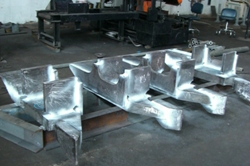
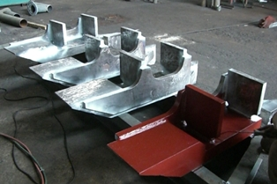
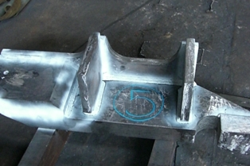
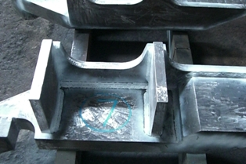
SENG HENG has Successfully completed:
Husman Crane Cather Block
Project Location: Global Offshore Supply & Engineering Pte Ltd

Slide 7
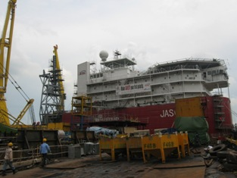
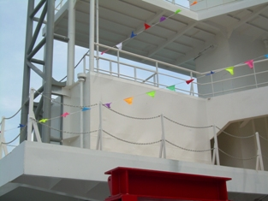
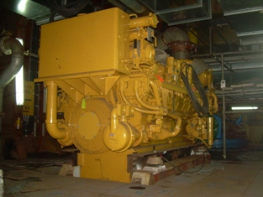
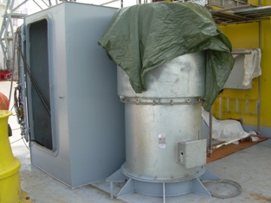
SENG HENG has Successfully completed
Vessel : Z MAGA Pipe laying barge
Project location : ASL Shipyard

Slide 8
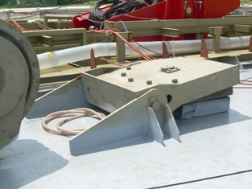
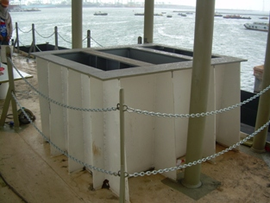
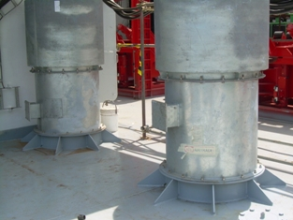
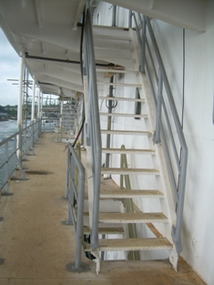
SENG HENG has Successfully completed
Vessel : MARINE QUEENIE Pipe laying barge
Project Location : ASL Shipyard

Slide 9
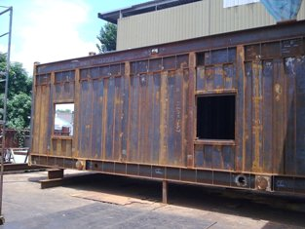
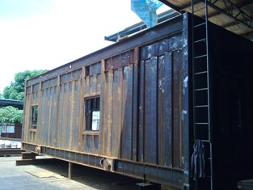
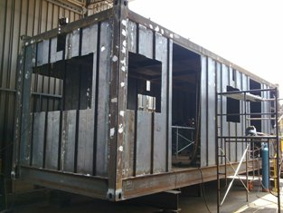
SENG HENG has Successfully completed
Control Van Assembly Container

Slide 10
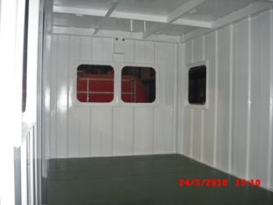
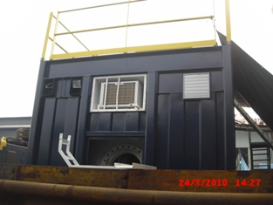
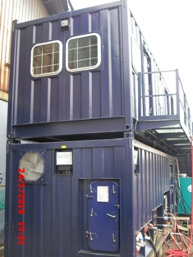
SENG HENG has Successfully completed
Control Van Assembly Container

Slide 11
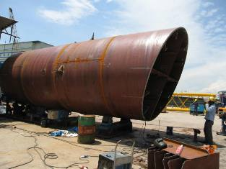
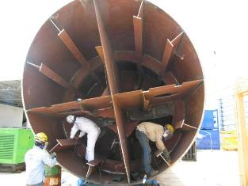
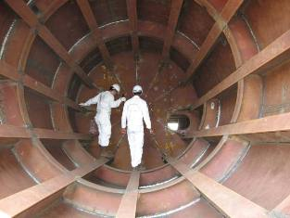
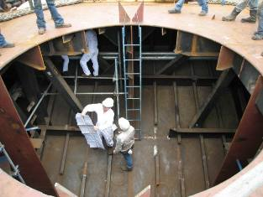
SENG HENG has Successfully completed:
Crest Support-5 Crane Column Pedestal

Slide 12
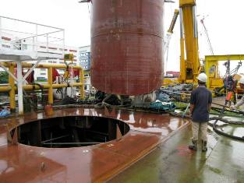
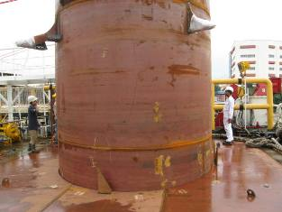
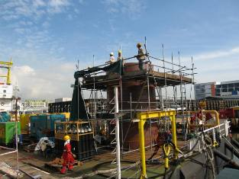
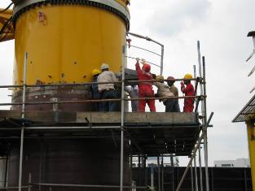
SENG HENG has Successfully completed:
Crest Support-5 Crane Column Pedestal

Slide 13
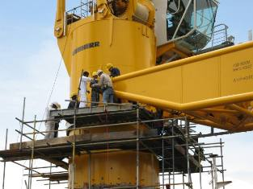
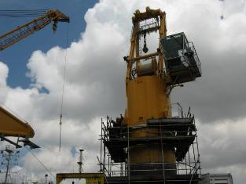
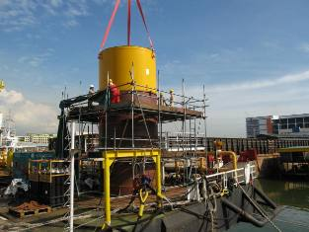
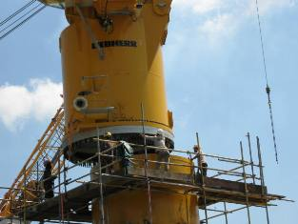
SENG HENG has Successfully completed:
Crest Support-5 Crane Column Pedestal

Slide 14
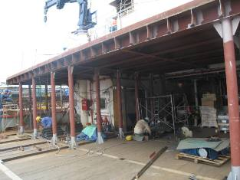
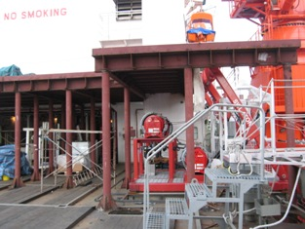
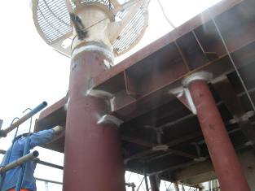
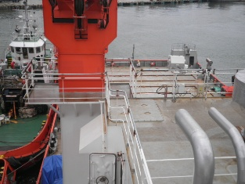
SENG HENG has Successfully completed:
Vessel : EPONYMA Various type of structural job
Project location : ASL Shipyard

Slide 15
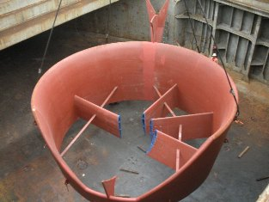
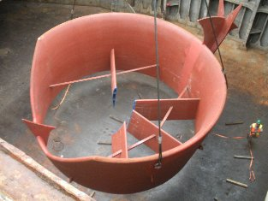
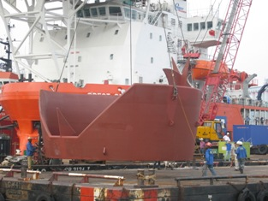
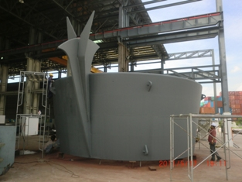
SENG HENG has Successfully Completed:
Becker Mewis Duct

Slide 16
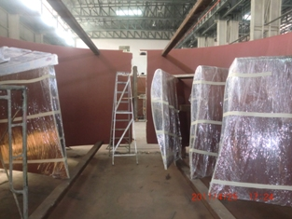
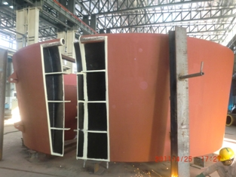
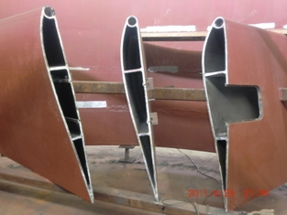
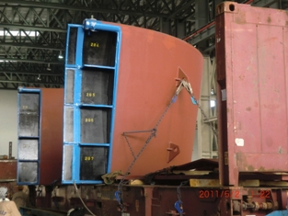
SENG HENG has Successfully Completed:
Becker Mewis Duct

Slide 17
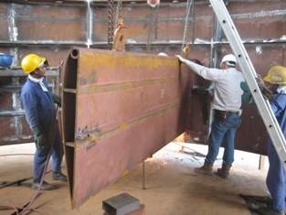
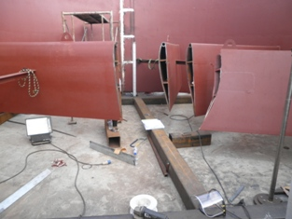
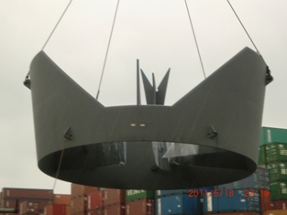
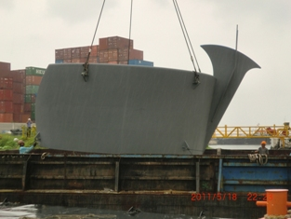
SENG HENG has Successfully Completed:
Becker Mewis Duct

Slide 18
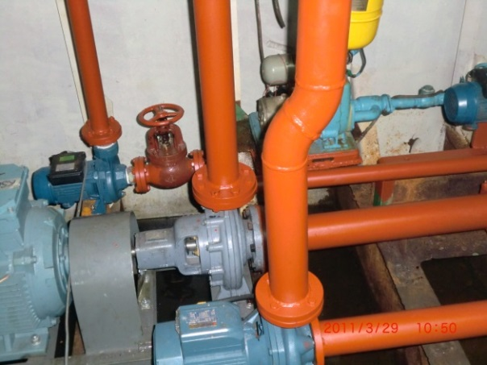
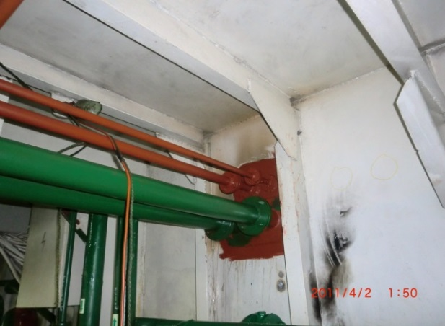
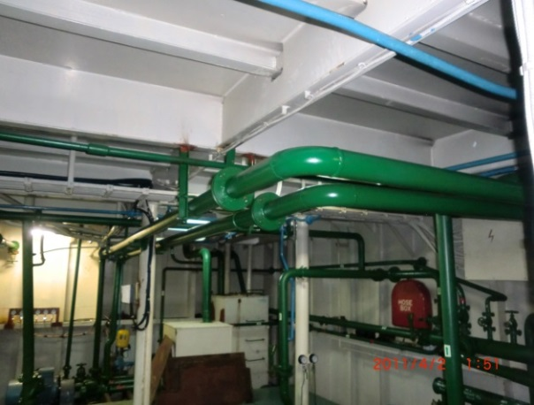



OUR CAPABILITIES & PROJECT REFERENCE
SENG HENG has Successfully completed of
PSA TG81(Piping Project)
System : Sea water cooling pipe line & Fuel pipe line
Pipe sizes : 4” x sch 80 x total length 22m x spools 15
Project Location: ASL Shipyard

Slide 19






SENG HENG has Successfully completed:
NOBLE ACE 41 (Piping Project)
System : Sea sand suction & discharge line
Pipe size : 20” x sch 80 x total length 22m x 16 spools
Project Location: ASL Shipyard

Slide 20






SENG HENG has Successfully completed
ORION WB 2(Piping project)
System : Filling & discharge pipe line for cement tanks
Pipe sizes : 4” x sch 80 x total length 23m x 14 spools
Project Location: ASL Shipyard

Slide 21




SENG HENG has Successfully completed:
Vessel : ORION WB 2 (Piping project)
System : Bilge oil pipe line
Pipe sizes : 4” x sch 80 x total length 16m x 14 spools
Project Location: ASL Shipyard

Slide 22




OUR CAPABILITIES & PROJECT REFERENCE
NEW PIPE LINE FABRICATION AND INSTALLATION

Slide 23








OUR CAPABILITIES & PROJECT REFERENCE
MECHANICAL / VALVES SERVICING AND ALL KIND
OF WORK IN SHIPYARD

Slide 24







OUR CAPABILITIES & PROJECT REFERENCE
MECHANICAL / VALVES SERVICING AND ALL KIND
OF WORK IN SHIPYARD

Slide 25





OUR CAPABILITIES & PROJECT REFERENCE
MECHANICAL / VALVES SERVICING AND ALL KIND
OF WORK IN SHIPYARD

Slide 26
QUALITY POLICY
We are committed to providing our clients with services which that provide effective and efficient solutions at a competitive price.
The following principals and objectives are key requirements in achieving this statement:
Our Quality Principals
Customers, employees and suppliers are essential to our success and shall be treated fairly and with respect in order that we can maintain an optimum working environment which delivers success for all.
The accuracy and completeness of processes, software, and hardware are equally important in the fulfilment of this policy.
Our Quality Objectives
To maintain high level of operational efficiency.
To achieve customer satisfaction and repeat business.
We strive to ensure a high quality in everything we do through applying our processes and resources to fulfil contractual and legal requirements. Through project and business performance feedback we will ensure that we continually learn from our activities and through this ensure that we can maintain or better our future performance.

Slide 27
OCCUPATIONAL HEALTH AND SAFETY, ENVIROMENTAL & QUALITY POLICY
Seng Heng Group is committed to achieving organizational excellence as a technical service provider for the execution and management of marine/offshore related projects.
We are committed to conducting our business activities in a manner that does not harm people or the environment.
Recognition by all employees that Safety and Environmental protection is a condition of employment and they shall be responsible in continuously improving safety.
Visible management commitment through active involvement in HSEQ matters and initiatives, leading by example and ensuring the individual contribution of all employees.
Measurable goals in place, promoting continual improvement towards a safer, healthier and more efficient organization.
Regular audits of our systems and performance.
Adherence to regulations, business, clients and legal requirements applicable to the countries in which we operate and utilizing local resources where practicable.
Endeavour to identify risks associated with our activities and ensure the appropriate control measures are in place to reduce the impact to the environment, the health and safety of our personnel and additionally the risks which may affect the condition of our assets and delivery of services.
Understanding our customers' requirements and taking pride in the quality of our work and services to satisfy and exceed their expectations.
Commitment to ensuring there are appropriate resources to implement this policy and making it available to both employees and the public.
Encourage the reporting of unsafe acts and conditions, near misses and accidents to people and the environment.
Seng Heng Group is a responsible organization and is committed to the health and safety of its employees and those who are exposed by its activities. We are focused on delivering a quality service which is recognized by our clients and rewards us with repeat business. Furthermore, we believe that successful Environmental management plays a significant role in our business, and we confirm our commitment to the prevention of pollution.

Slide 28
HEALTH AND SAFETY STATEMENT OF COMMITMENT
We will:
Constantly emphasise that Health and Safety is an equal element of our business profile.
Help prevent accidents, incidents and dangerous occurrences by reducing risks to ALARP through the involvement of our workforce in briefings, toolbox talks and risk assessment.
Reinforce your right to stop work if you feel it is unsafe.
Encourage the reporting of unsafe acts and conditions, near misses and accidents.
Continual improvement through lessons learnt from any undesired event or positive action report.
Support and promote safe behaviour and working practice in the workplace.
Ensure that any safety observations are recorded, and remedial action taken, as far as reasonably practicable, ASAP
Contribute as far as reasonably practicable to any innovative new ideas which could help to improve safety at the workplace.
Ensure that PPE is used as a safety precaution on all worksite designated areas, including the use of hard hats, coveralls, boots, glasses, gloves. In cases where this is not practicable a risk assessment recorded on the PPE Dispensation Form authorised by the site senior manager must be in place to define what is acceptable.
Monitor our H&S performance
We want:
Common goals
Honest and open discussion
No hidden agendas
Enjoyable employment
Employee satisfaction
Constructive input
Mutual respect

Slide 29
DRUG AND ALCOHOL POLICY
The company is committed to provide a safe and healthy working environment. It recognises that this can be put at risk by those who misuse alcohol or drugs to such an extent that it may affect their health, performance, conduct and relationships at work.
The policy, which applies to all employees, aims to:
Promote the health and well-being of employees and to minimise problems at work arising from the effects of alcohol or drugs
Identify employees with possible problems relating to the effects of alcohol or drugs at an early stage
Offer employees known to have alcohol or drug-related problems affecting their work referral to an appropriate source for diagnosis and treatment if necessary.
The use of alcohol is not appropriate in the workplace and drug abuse can be a criminal offence as well as a serious risk to health and safety.
The four most important steps are to:
Look after your own health and safety by developing a responsible attitude towards alcohol and drugs
Declare any prescription medication you are taking to your line manager and if offshore, also the onboard medic
Be aware of colleagues or others who may put safety at risk by their actions
Recognise when and how to ask for help.
The effects of alcohol or drugs at work can create serious health and safety risks. Therefore, the following rules should be adhered to:
1. Do not come to work under the influence of alcohol or drugs. The company tolerance level for alcohol is the same as applicable national Drink and Driving legislation. The company recognises a zero-tolerance level for drug abuse
2. Do not bring alcohol or non-prescribed drugs on to company premises.
3. Check with your doctor or pharmacist about the side-effects of prescribed medications.
4. Never drive or operate machinery if you are affected by alcohol or drugs.
5. Ask your general practitioner or the company for guidance and advice on sensible limits of alcohol consumption.
6. Offer support and advice to colleagues who you suspect of suffering from alcohol or drug abuse: do not "protect" them by keeping silent.
7. Ask for assistance if you feel that matters are beyond your own control.
An employee who commits a clear breach of this company policy will be subject to the company disciplinary procedure as appropriate.

Slide 30
ANTIBRIBERY & CORRUPTION(ABC) POLICY
Seng Heng Group is committed to conducting business in an ethical and honest manner and is committed to implementing and enforcing systems that ensure bribery is prevented.
Seng Heng Group has zero-tolerance for bribery and corrupt activities. We are committed to acting professionally, fairly, and with integrity in all business dealings and relationships.
Seng Heng Group will constantly uphold all laws relating to anti-bribery and corruption in Singapore. We are bound by the laws of Singapore, including the Singapore Prevention of Corruption Act (PCA).
Seng Heng Group recognizes that bribery and corruption are punishable by imprisonment and/or a fine. If our company is discovered to have taken part in corrupt activities, we may be subjected to an unlimited fine, be excluded from tendering for public contracts, and face serious damage to our reputation. It is with this in mind that we commit to preventing bribery and corruption in our business and take our legal responsibilities seriously.
We must at all times comply with the ABC Policy and relevant anti-bribery and corruption laws in Singapore.

